Slide 1
One-Way Arbitrage and Its Implications for the Foreign Exchange Markets
Alan V. Deardorff
Gerald R. Ford School of Public Policy
University of Michigan
For presentation at Beijing Institute of Technology
June 8, 2012, Beijing

Slide 2
The Issue
How closely are spot and forward exchange markets tied together?
The standard answer is based on “covered interest arbitrage” (CIA)
I argue that, in the presence of small transactions costs,
Exchange rates will be tied closer together than that form of arbitrage can explain
“One-way arbitrage” (OWA) instead will constrain the rates
Covered interest arbitrage will never occur

Slide 3
The Source
Alan V. Deardorff, “One-Way Arbitrage and Its Implications for the Foreign Exchange Markets,” Journal of Political Economy 87(2), April 1979, pp. 351-364.

Slide 4
Conventional versus One-way Arbitrage
In conventional arbitrage, an agent from outside of two or more markets exploits price differences to make a profit.
In one-way arbitrage, a buyer or seller from inside these markets chooses among them to minimize cost.

Slide 5
Conventional versus One-way Arbitrage
Example: Price of tomatoes in two markets, P₁ and P₂. Suppose P₁<P₂
Conventional arbitrage would have an entrepreneur buy tomatoes in market 1 at price P₁ and sell them in market 2 at price P₂. That would raise P₁ and lower P₂.
One-way arbitrage would have buyers of tomatoes just buy from the lower-priced market. That would prevent any sales at the higher price.

Slide 6
Conventional versus One-way Arbitrage
Without transactions costs, implications are the same: P₁ = P₂.
With transactions costs, implications are different
Conventional arbitrageur incurs 2 costs, one buying and one selling
One-way arbitrageur incurs only 1 cost, and it may be the same for both markets, making it irrelevant
Thus one-way arbitrage will drive prices closer together than conventional arbitrage

Slide 7
Conventional versus One-way Arbitrage
My story is just this one, but told in the more complex world of four markets:
Spot market
Forward market
Domestic securities market
Foreign securities market
What these markets trade are really four goods:
Domestic money now
Foreign money now
Domestic money in the future
Foreign money in the future
For exchanging domestic and foreign currencies
For borrowing and lending

Slide 8
The “Goods”
PRESENT
FUTURE
$₀
$₁
DOMESTIC
£₀
£₁
FOREIGN

Slide 9
The Markets
DOMESTIC SECURITIES
$₀
$₁
SPOT
FORWARD
£₀
£₁
FOREIGN SECURITIES

Slide 10
The Rates (without t-costs)
(1+i)
$₀
$₁
1
(1+i)
1
($₁/£₁=)F
1
($₀/£₀=)S
S
F
(1+i*)
£₀
£₁
1
(1+i*)

Slide 11
Covered Interest Arbitrage (without t-costs)
(1+i)
$₀
$₁
1
(1+i)
1
($₁/£₁=)F
1
($₀/£₀=)S
S
F
(1+i*)
£₀
£₁
1
(1+i*)
1
(1+i*)
C($₀1) =
F
1
=
F
≥1
Otherwise profit > 0 from clockwise path.
(1+i*)
S
(1+i)
S
(1+i)
(1+i)
C($₀1) =
(1+i)
1
1
S
=
S
≥1
Otherwise profit > 0 from counter-clockwise path.
F
F
(1+i*)
(1+i*)
(1+i*)
(1+i)
➔
F
= 1
➔
F = F₀ = S The “Interest Parity Value”
S
(1+i)
(1+i*)

Slide 12
The Forward Premium (without t-costs)
The Forward Premium is the percentage by which the forward rate exceeds the spot rate.
Thus
P =
F-S
S
F₀-S
(1+i)
(1+i)−(1+i*)
P₀ = = −1 = ≈ i − i*
S
(1+i*)
(1+i*)

Slide 13
The Rates (with t-costs)
(1+i)(1+t)
$₀
$₁
1
(1+t)
(1+i)
1
F(1+t_{F})
1
(1+t_{F})
S(1+t_{S})
(1+t_{S})
F
S
(1+i*)(1+t*)
£₀
£₁
1
(1+i*)
(1+t*)

Slide 14
Covered Interest Arbitrage (with t-costs)
(1+i)(1+t)
$₀
$₁
1
(1+t)
(1+i)
1
F(1+t_{F})
1
(1+t_{F})
S(1+t_{S})
(1+t_{S})
F
S
(1+i*)(1+t*)
£₀
£₁
1
(1+i*)
(1+t*)
1
1
C($₀1) =
(1+t_{S})
(1+i*)(1+t*)
F(1+t_{F})
(1+t)
S
(1+i)
(1+i*)
F
=
(1+t)(1+t*)(1+t_{S})(1+t_{F})
≥ 1
S
(1+i)
Thus

Slide 15
Similarly
(1+i)(1+t)
$₀
$₁
1
(1+t)
(1+i)
1
F(1+t_{F})
1
(1+t_{F})
S(1+t_{S})
(1+t_{S})
F
S
(1+i*)(1+t*)
£₀
£₁
1
(1+i*)
(1+t*)
C($₀1) =
1
1
(1+i)(1+t)
F
(1+t_{F})
(1+i*)
(1+t*)
S(1+t_{S})
(1+i)
S
=
(1+t)(1+t*)(1+t_{S})(1+t_{F})
≥ 1
F
(1+i*)
Thus

Slide 16
Combining the limits due to both directions of CI arbitrage:
Note that &
when x,y are small (as t, t*, etc. are).
Then
Thus the divergence of F from F₀ is bounded by the sum of the four transactions costs.
Limits due to CIA

Slide 17
One-Way Arbitrage
(1+i)(1+t)
$₀
$₁
1
(1+t)
(1+i)
1
F(1+t_{F})
1
(1+t_{F})
S(1+t_{S})
(1+t_{S})
F
S
Consider a trader who wants to exchange $₀ for £_{0.}
(1+i*)(1+t*)
£₀
£₁
1
(1+i*)
(1+t*)
They can buy £₀ in the spot market for cost
Or they can achieve the same result by
Lending dollars domestic,
Buying pounds forward, and
Borrowing pounds abroad.
If OWA Cost < direct cost, then nobody will demand pounds on the spot market!
S(1+t_{S})
OWA Cost:
1
(1+t)
F(1+t_{F})
(1+i*)(1+t*)
(1+i)

Slide 18
Implication of OWA
If supply in the spot market is positive, then equilibrium requires that demanders not prefer OWA, and therefore that
or
Using F₀ and the approximations, this is
S(1+t_{S})
≤
1
(1+t)
F(1+t_{F})
(1+i*)(1+t*)
(1+i)

Slide 19
Implications of OWA
That may not seem likely to be binding. But if we repeat this sort of analysis for suppliers and demanders of both spot and forward pounds, we get four conditions, all of which must hold in order for both spot and forward markets to be used.
These are shown in TABLE 1 of the paper.

Slide 20
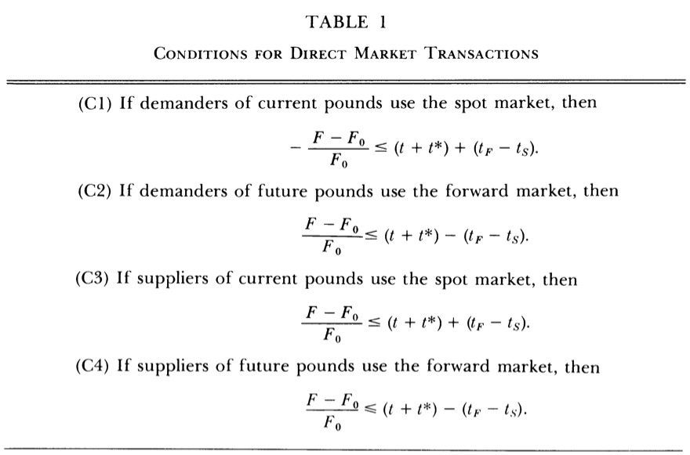
Implications of OWA
NOTE ERROR: Should have a minus sign
−

Slide 21
These constrain where demands and supplies are positive, and thus where equilibrium is possible.
Spot Demand > 0:
Future Demand > 0:
Spot Supply > 0:
Future Supply > 0:
−

Slide 22
Spot Demand > 0:
Spot Demand > 0:

Slide 23
Future Demand > 0:
Future Demand > 0:

Slide 24
Spot Supply > 0:
Spot Supply > 0:

Slide 25
Future Supply > 0:
Future Supply > 0:

Slide 26
In combination:
Future Demand > 0:
Spot Supply > 0:
Spot Demand > 0:
Future Supply > 0:

Slide 27
In combination:
Future Demand > 0:
Spot Supply > 0:
Spot Demand > 0:
Future Supply > 0:
BOTH MARKETS TRADE

Slide 28
In combination:
Future Demand > 0:
Spot Supply > 0:
Spot Demand > 0:
Future Supply > 0:
SPOT MARKET ONLY TRADES

Slide 29
In combination:
Future Demand > 0:
Spot Supply > 0:
Spot Demand > 0:
Future Supply > 0:
FORWARD MARKET ONLY TRADES

Slide 30
EQUILIBRIA:
Future Demand > 0:
Spot Supply > 0:
Spot Demand > 0:
Future Supply > 0:

Slide 31
Constraints Imposed by OWA
A necessary (but not sufficient) condition for equilibrium is given in the paper as
This excludes the dark-red shaded areas as follows…

Slide 32
DISEQUILIBRIA:
Future Demand > 0:
Spot Supply > 0:
Spot Demand > 0:
Future Supply > 0:

Slide 33
Compare Constraints Imposed by OWA and CIA
OWA:
CIA:
If t_{S} , t_{F}> 0, then K_{OWA} < K_{CIA}
Thus OWA will prevent rates ever departing as far from interest parity as CIA would permit

Slide 34
Stronger Constraint if Trade in Both Markets
Recall the smaller area in the figure where there is positive trade in both markets. This requires the following stronger constraint:
Note however that this is relevant only to the interbank market, where trades ultimately take place.
Retail clients may place orders with banks to both buy and sell on both markets, while the banks themselves use, say, only the spot and securities markets to effect the transactions.
The fact that forward exchange rates are quoted does not mean that the banks are necessarily engaging in forward contracts among themselves.

Slide 35
Implications of the Results
Deviations from covered interest parity will not be as large as predicted by Covered Interest Arbitrage.
Covered Interest Arbitrage will not happen.
The “Paradox” of Perfect Arbitrage
With CIA, students wonder how equilibrium can be sustained by CIA transactions that make no profit.
But OWA does not require profit, only cost minimization by market participants.

Slide 36
Implications of the Results
Measurement of Exchange Market Performance
Frenkel and Levich (1975) measured transactions costs in all 4 markets and tested the CIA prediction.
Better to have tested the OWA prediction.
Using their estimates of transaction costs, the two become:
The latter is less that 1/3 as large, so it may matter.

Slide 37
Implications of the Results
Viability of the Forward Market
Frenkel and Levich always found t_{F} > t_{S}
They provided three estimates of t_{F} −t_{S} , all from 1962-67 data:
And one estimate of t+t*:
This suggests that, while
Their estimate of of t_{F} = 0.070 %. It wouldn’t need to rise much to turn this negative, and prevent transactions in the forward market.
McKinnon (1976) notes just such an increase with flexible exchange rates, and indeed use of the forward market was limited.

Slide 38
Caveats
Other considerations that could limit arbitrage of both kinds
Arbitrage funds may be limited (Keynes 1923)
Interest rates may depend on borrower’s balance sheet (Prachowny 19970 & Frenkel 1973)
Assets provide convenience yield, so interest rate is not the only thing that matters (Tsiang 1959)
Political risk exists and differs across countries (Aliber 1973)

Slide 39
Caveats
All of these caveats may weaken the ability of both CIA and OWA to restrict deviations from interest parity.
They are more likely when arbitrageurs have substantial uncompleted contracts, as is likely during “turbulent periods”. Thus, as Frenkel & Levich (1977) find, it makes sense that violations of our conditions are then more likely.
But note that all these caveats apply to both CIA and OWA, and they do not therefore undermine the prediction that CIA is unlikely to occur.

